Slide 1






PREDICTING HOSPITAL COST
BY PINPIN
Regression

Slide 2

BACKGROUND
This is a dataset to predict the hospital cost in US hospitals based on various patient information, such as ID, Age, Gender, BMI, Region

Slide 3







TABLE OF CONTENTS
DATASET EXPLORATION
DATASET PROCESSING
MODEL SELECTION
MODEL IMPROVEMENT

Slide 4
DATA DICTIONARY
Name | Data Type | Description
ID | Numeric | Counter Starting from 1 - 1337
Age | Categorical | In years
BMI | Numeric | weight(kg) / height(m)^2
Smoker | Categorical | Smokes tobacco or cigarette regularly
Region | Categorical | Northeast | Northwest | Southeast | Southwest
Cost | Numeric | total amount paid ($)

Slide 5



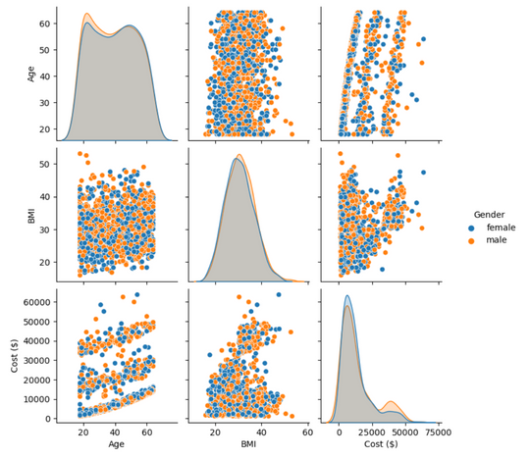
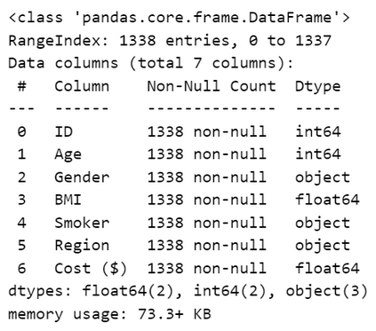
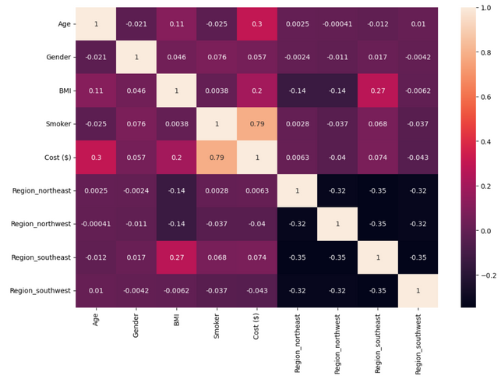


DATA EXPLORATION
FUNCTIONS USED
patient_info.shape
patient_info.info()
patient_info.describe()
patient_info.isna().sum()
In our Dataset, we have:
A Target Variable: ("Cost") and 6 Features
Shape = (1338, 7)
categories that are categorical:
Gender
Smoker
Region

Slide 6
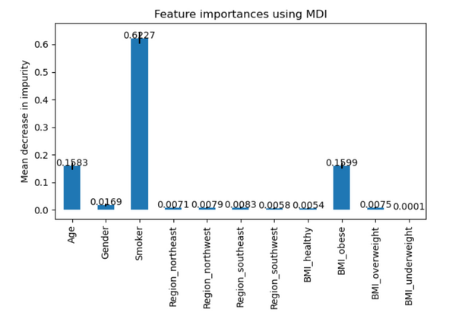
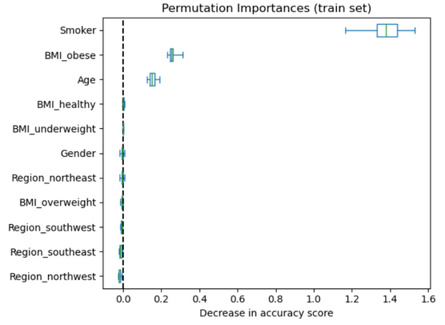
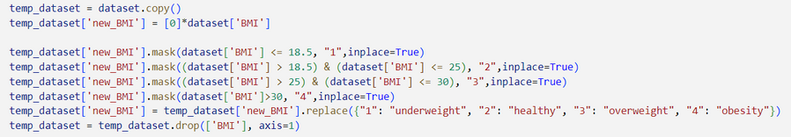
FEATURE ENGINEER
NEW FEATURE
BMI calculating the amount of body fat in one's body
BMI X < 18.5 underweight range
BMI 18.5 < X < 25, healthy weight range
BMI 25.0 < X < 30, overweight range
BMI 30.0 < X, obesity range
Binning
A way to group a number of more or less continuous values into a smaller number of "bins"

Slide 7






DATASET PROCESSING

Slide 8
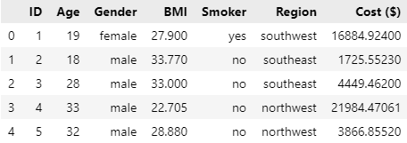

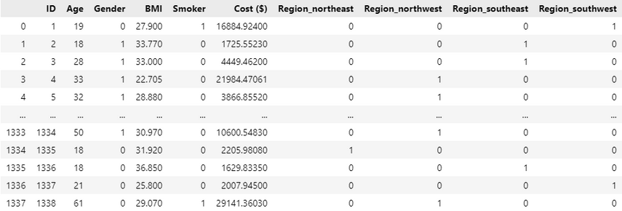
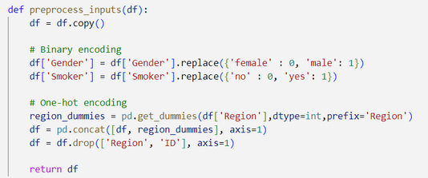
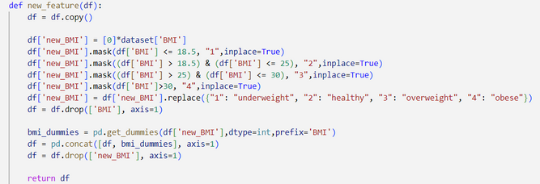
ORDINAL ENCODING
THE TRANSFORMATION OF DISCRETE (BINARY OR MULTINOMINAL) VARIABLES TO NUMERIC.
Before
Categorical Data
Gender [male | Female]
Smoker [yes | no]
Region [Northeast | Northwest | Southeast | Southwest]
newBMI [Underweight | Healthy | Overweight | Obese]
After

Slide 9
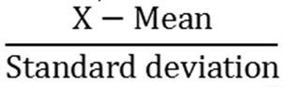
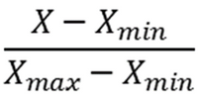
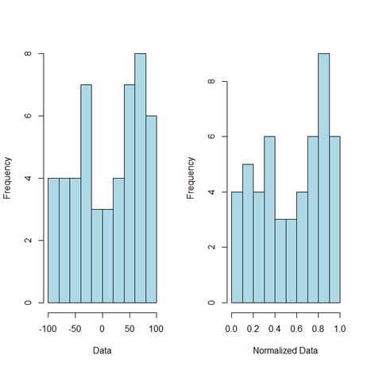
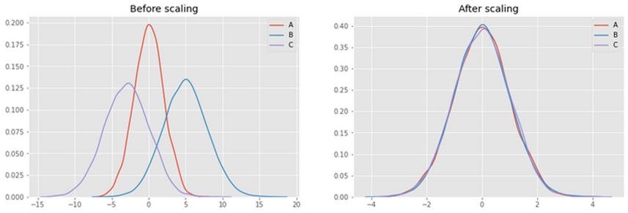
SCALING
INCREASING | DECREASING VALUES
Standarization
Normalization
MEAN = 0
STANDARD DEVIATION = 1
SCALING THE DATA TO FALL BETWEEN 0 AND 1

Slide 10



MODEL SELECTION

Slide 11




SCORING METHODS
REGRESSION
MSE
RMSe
Mean Squared Error
Square all values and get mean
Root Mean Square Error
√MSE
Note: Best model LOW MSE & MAE
HIGH R²
R²
MAE
Coefficient of determination
-∞ <X < 1
R² = 0 (Predicted Mean)
R² = 1 (Predicted Exact)
Mean Absolute Error
Get Absolute of all values and get mean

Slide 12
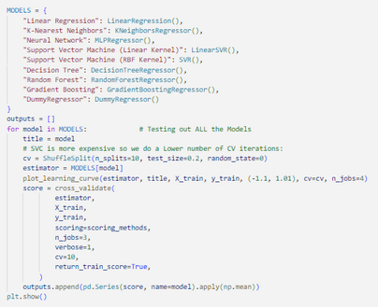
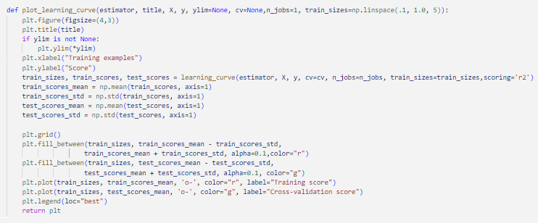
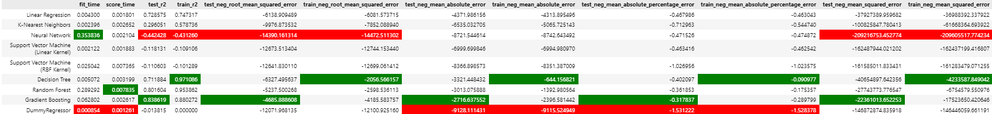
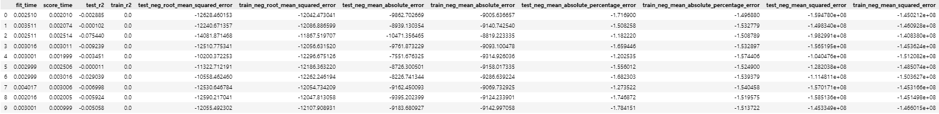
Model Bulding
CHOOSING MODEL
We create a function to repeat the steps for all models
Overall Model Status
Baseline Results

Slide 13
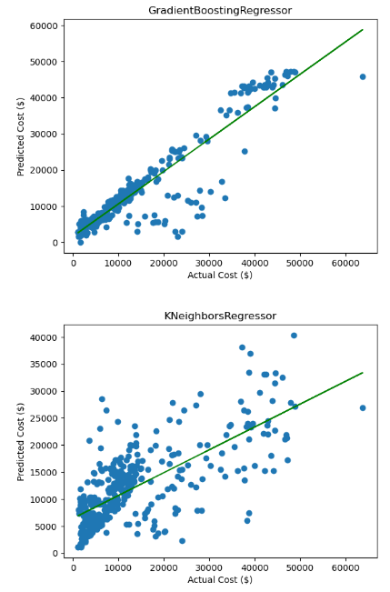
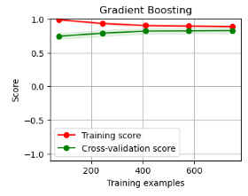
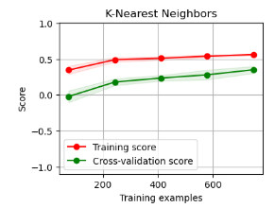
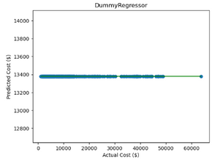
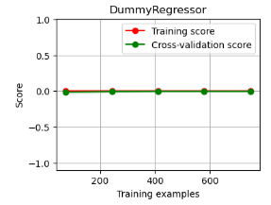
Model Selection
GRADIENTBOOSTING
It uses an Ensemble of weak prediction models
K-NEAREST NEIGHBORS
Approximates between independent and continuous outcome by Neighbors
BASELINE

Slide 14
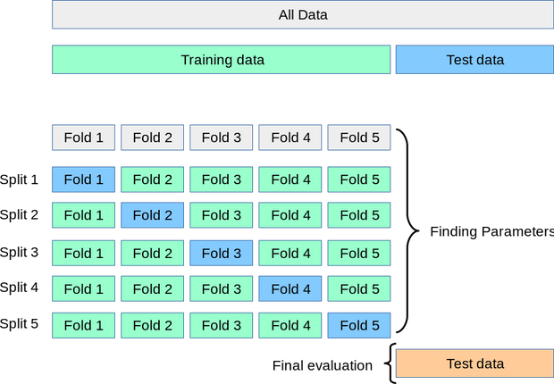
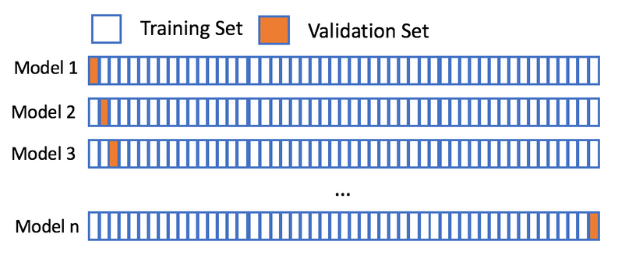
CROSS VALIDATION
K-FOLDS
LEAVE-ONE-OUT
splitting into k-subsets
validate for k-times
same thing as K-folds but it splits it into 1row (test) rest (train)
Very time consuming

Slide 15



MODEL IMPROVEMENT

Slide 16

WAYS TO IMPROVE
1. Hyperparameter Tuning
Changing the default parameters of the model to best fit the data given
2. REGULARIZATION
Calibrate models to prevent overfitting or underfitting
3. ENSEMBLE METHODS
Combining multiple models instead of using a single model

Slide 17
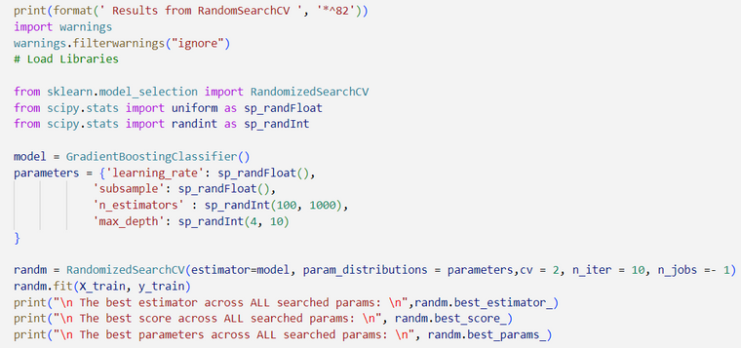
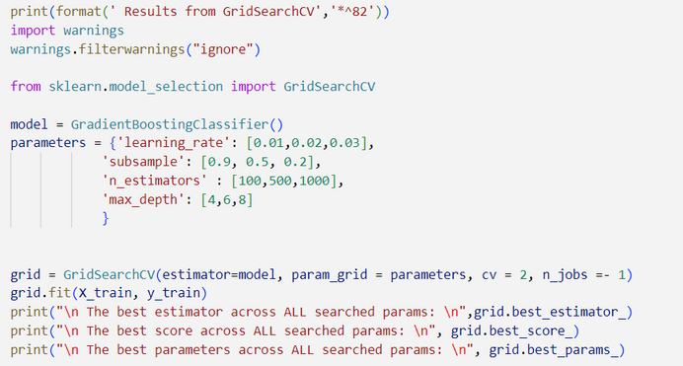
WAYS TO IMPROVE
Hyperparameter Tuning
Parameter:
learning_rate
subsample
n_estimators
max_depth
Changing the default parameters
GridSearchCV
A technique to search through All the parameter values from the given set of the grid of parameters
RandomSearchCV
A technique to search through Random parameter values from the given set of the grid of parameters

Slide 18
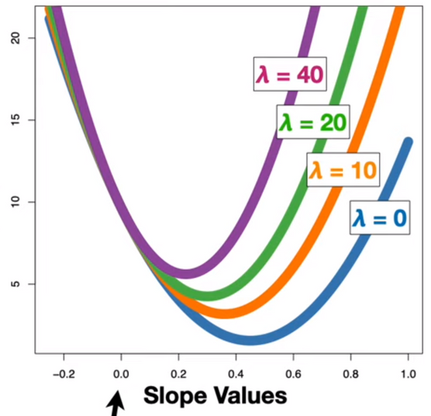
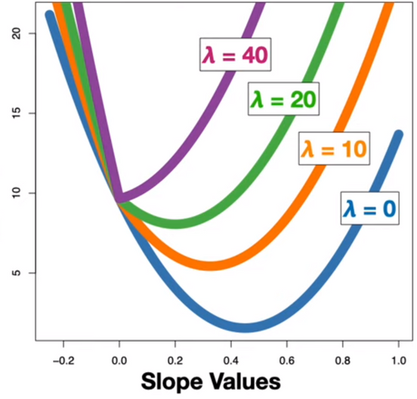
WAYS TO IMPROVE
Regularization
Ridge
Lasso
Sum of the squared residuals + λ * the slope²
Sum of the squared residuals + λ * |the slope|
lasso also exclude useless variables from the equation

Slide 19
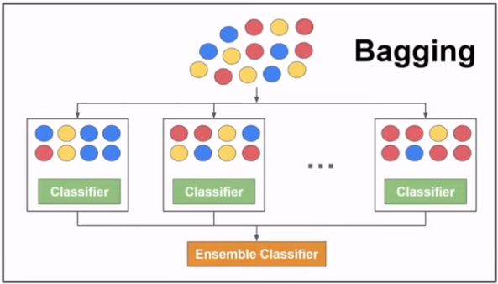
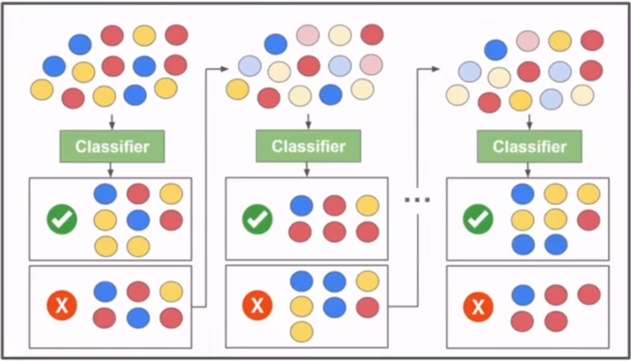
WAYS TO IMPROVE
Ensemble Methods
Bagging (Parallel)
Boosting (Squential)
Decreases variance
Prevents Overfitting
Making a Stronger model with the wrongly predicted values

Slide 20
SUMMARY
Dataset exploration
Dataset processing
Model selection
Model improvement
FOUND OUT WHAT DATA WE ARE WORKING WITH AND HOW THEY RELATED WITH EACH OTHER
IMPUTED AND SCALED DATA SO MODEL CAN LEARN MORE EFFECTIVELY
FEATURE ENGINEERING
SCORING METHODS ON ALL OF the models and evaluated using graphs
3 WAYS OF IMPROVING
HYPERPARAMETER TUNING
ENSEMBLE METHODS
REGULARIZATION

